Slide 1
Chapter 5 One-dimensional groundwater flow
Governing partial differential equation
Aquifers of half-infinite extent
Driving sinusoidal waves ast x=0
Sudden head changes at x=0
Aquifers of limited extent (strip of land of given width)
Groundwater basins and their characteristics

Slide 2
Derivation of basic partial differential equation (which is a water budget)
Unonfined situation
Confined situation

Slide 3
With constant aquifer thickness D and zero recharge (n=0)
Let the meaning of this equation sink in.
It becomes obvious when you consider a small aquifer slice of width 𝛥x.
Integrate over the distance x to x + 𝛥x:
Showing the net inflow on the left equaling the storage on the right

Slide 4
Analytical solutions to the partial differential equation (PDE)
Must fulfill the PDE
Must fulfill the innitial condition
Must fulfill the boundary conditions
One set of solutions have the form
Cycle time:

Slide 5
Proof that the solution is correct How?
Fill it into the PDE
Then see that
And, therefore, the solution is
Boundaries
Envelopes
c can be any constant

Slide 6
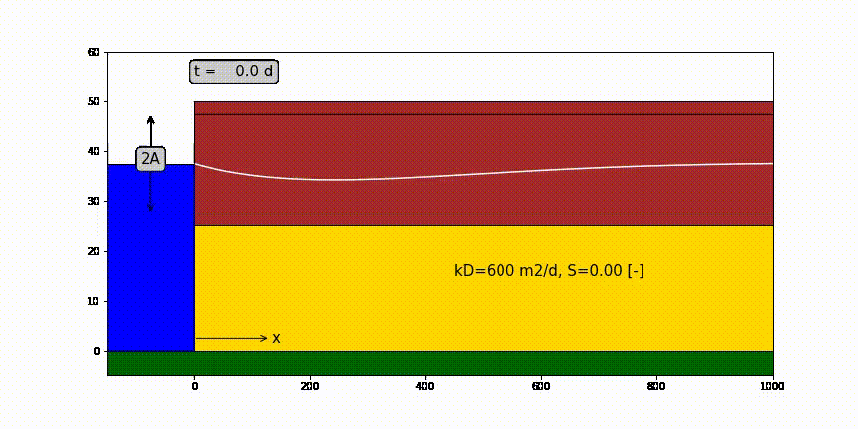
One-dimensional half infinite confined aquifer bounded by surface water at x=0 in which water level fluctuation like a sine.

Slide 7
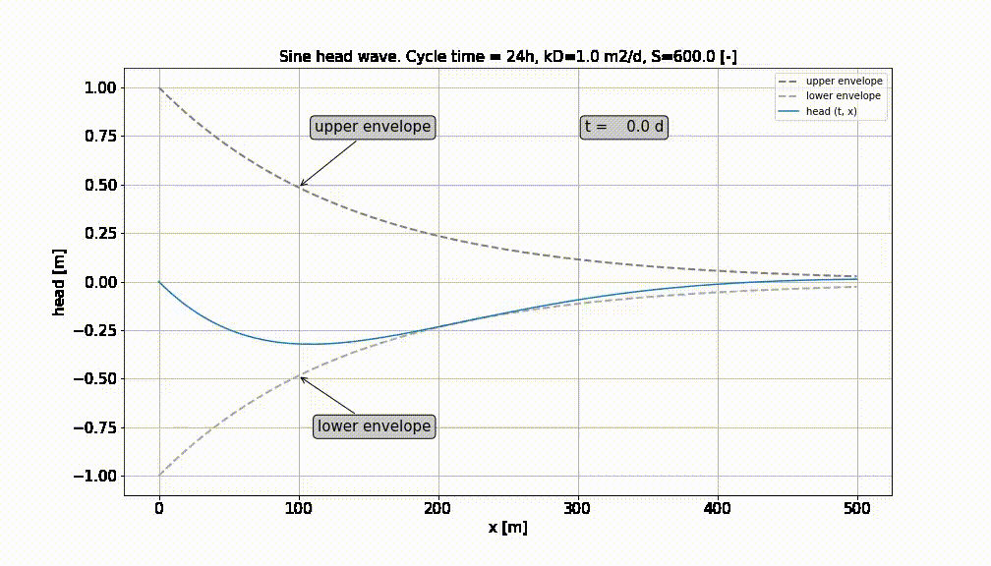

Slide 8
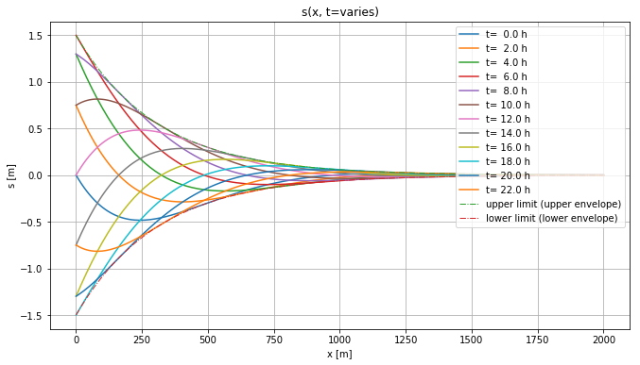
Head in aquifer at different times. Always stays within envelopes

Slide 9
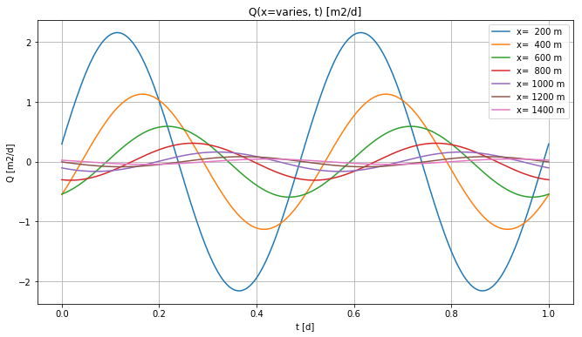
Heads at different x

Slide 10
Head and discharge in the aquifer
Head:
Discharge:

Slide 11
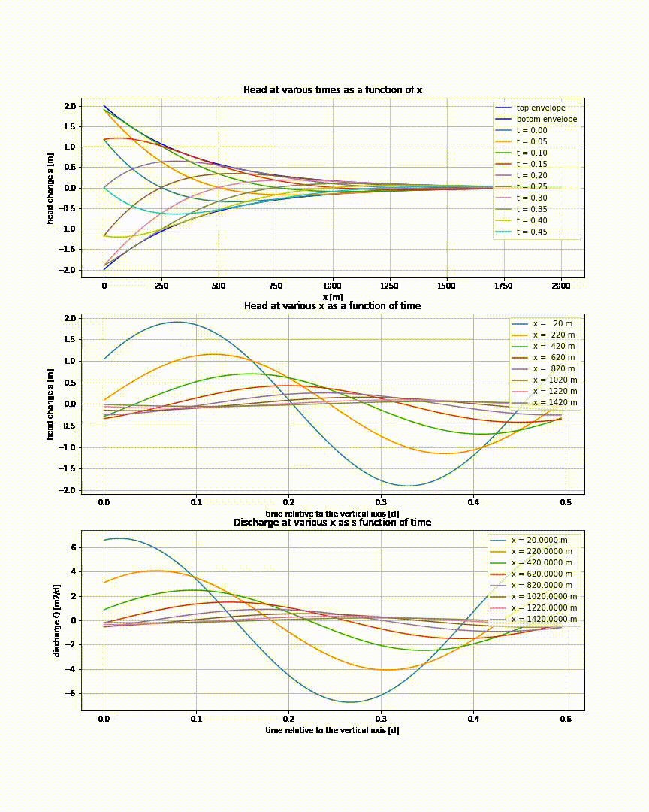

Slide 12
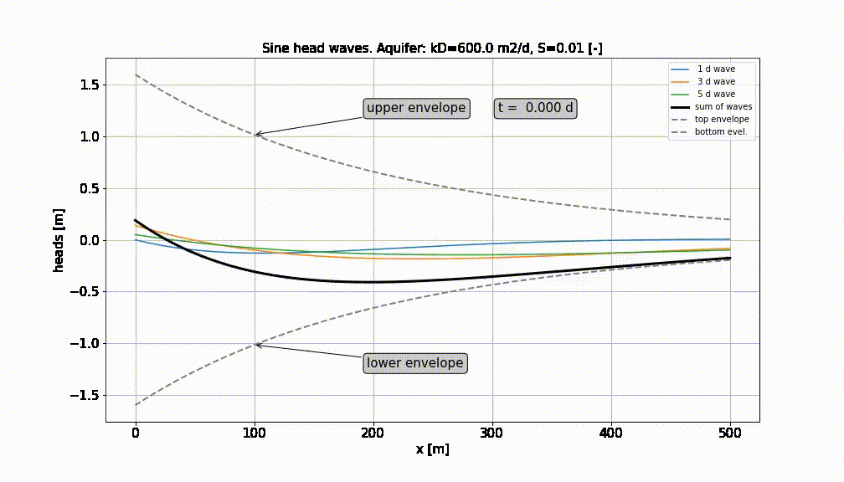
Superpostion of a number of sine-waves

Slide 13
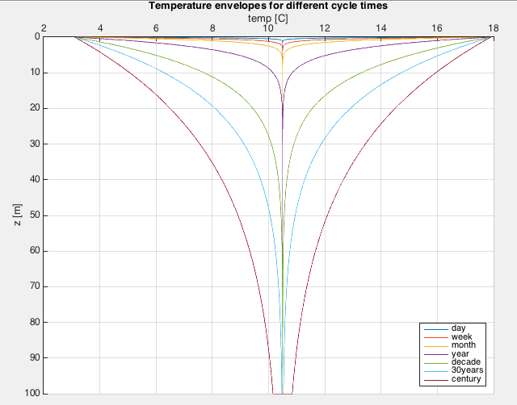
Sec. 5.3.2: Temperature fluctuations

Slide 14
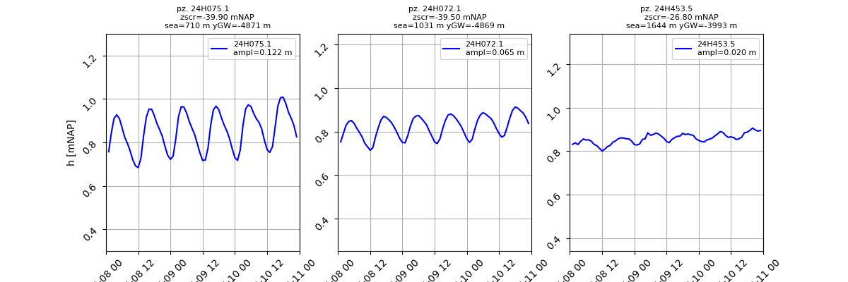
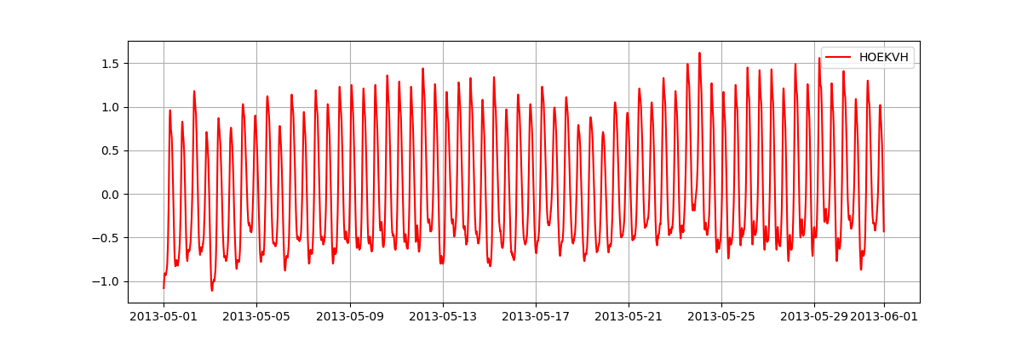
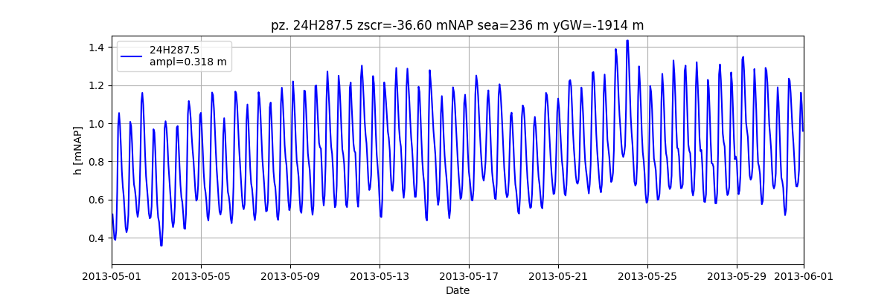
Tides in Amsterem Water Supply Dunes

Slide 15
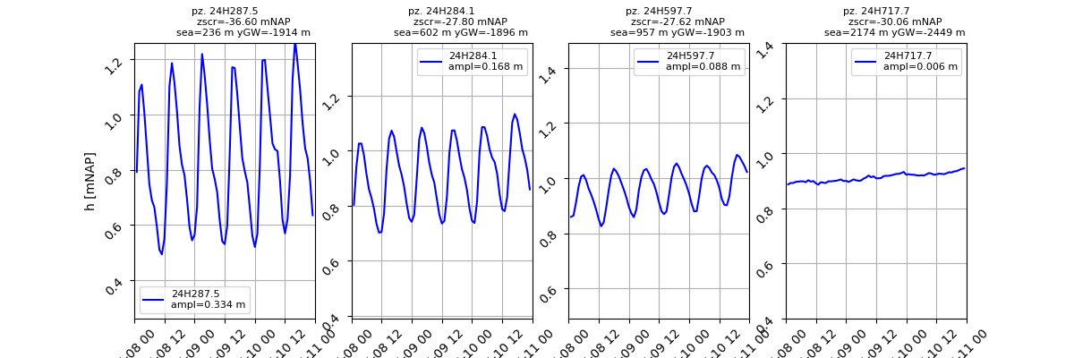
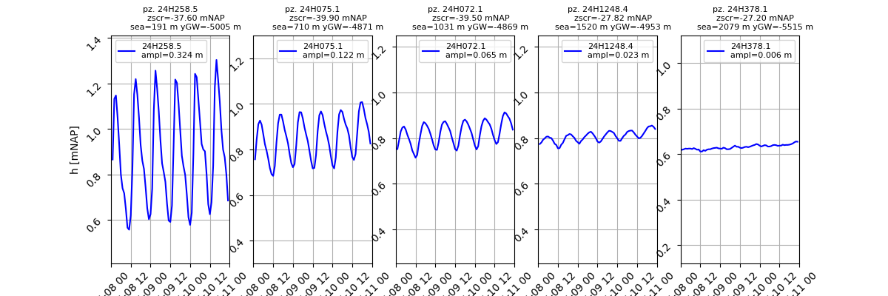
Tides in Amsterem Water Supply Dunes

Slide 16
Tides in Amsterem Water Supply Dunes

Slide 17
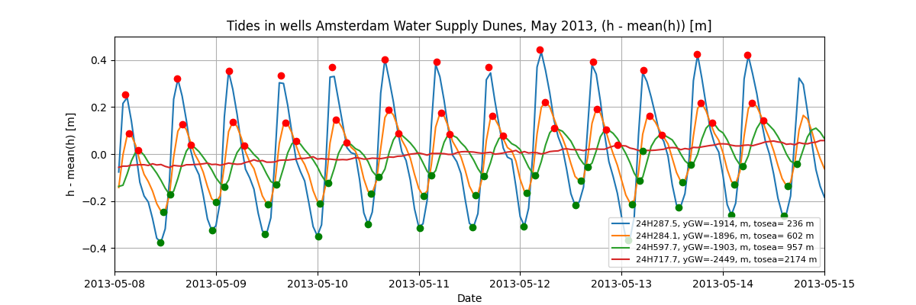
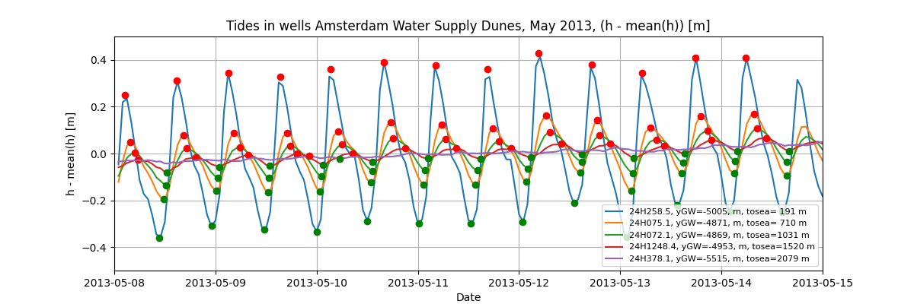
Delay as a function of distance from source

Slide 18
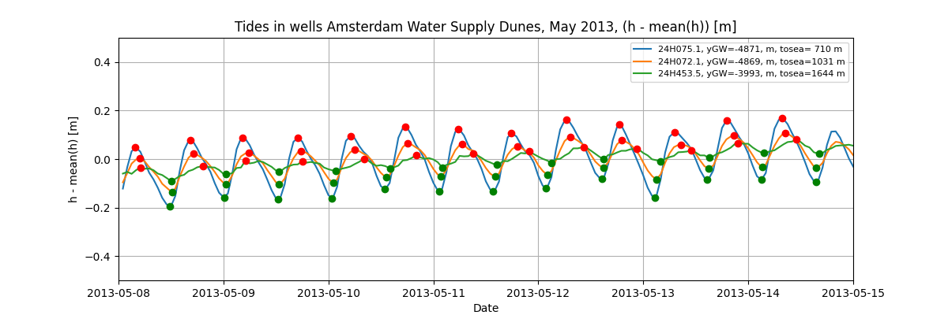
Delay as a function of distance from source

Slide 19
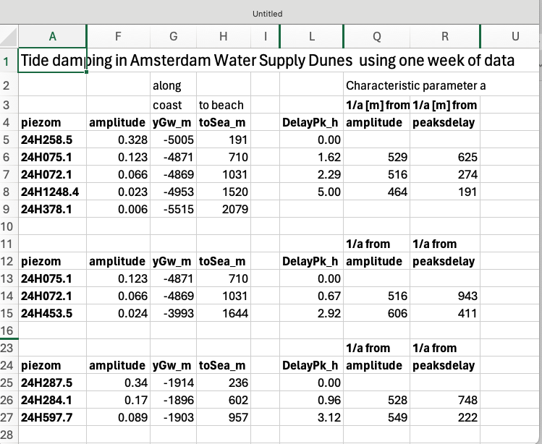
Tide analysis

Slide 20
Exercises and questions
See section 5.3.4
See old exams bundle

Slide 21
Sec. 5.4 sudden head change at x=0
Basins of half-infinite extent (as before)
Same partial differential equation
Different solution

Slide 22
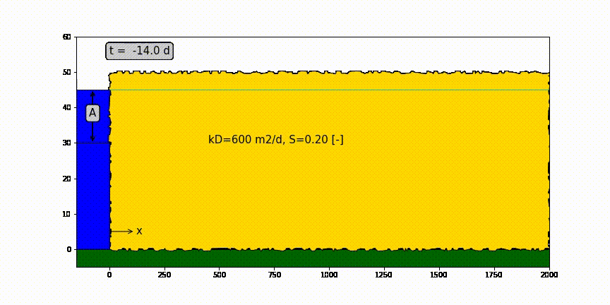
Head change due to sudden head change at x=0

Slide 23
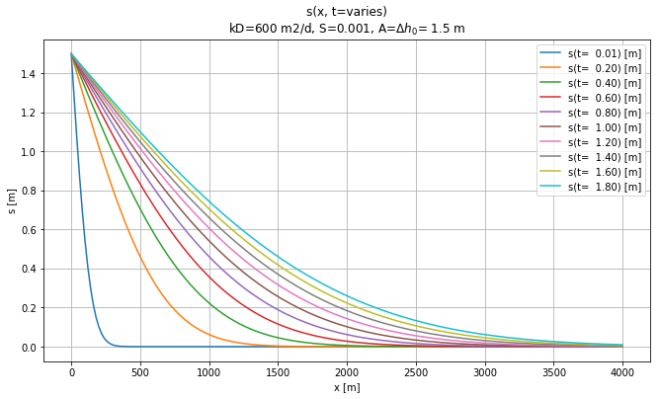
Effect of sudden rise of head at x=0 and t=0

Slide 24
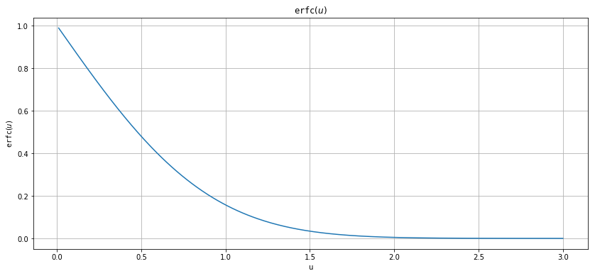
erfc(u) as a function of u

Slide 25
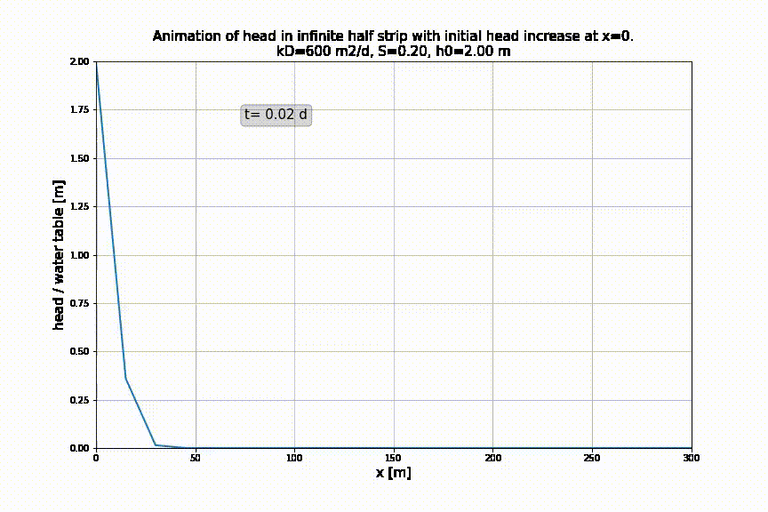
Aquifer intruded at x=0 by sudden change. Head at various t

Slide 26
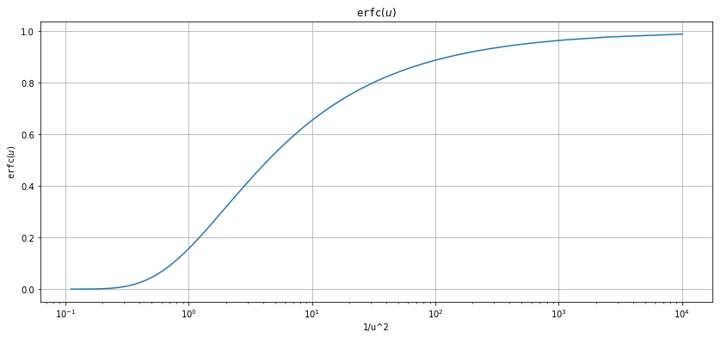
erfc(u) as function of 1/u

Slide 27
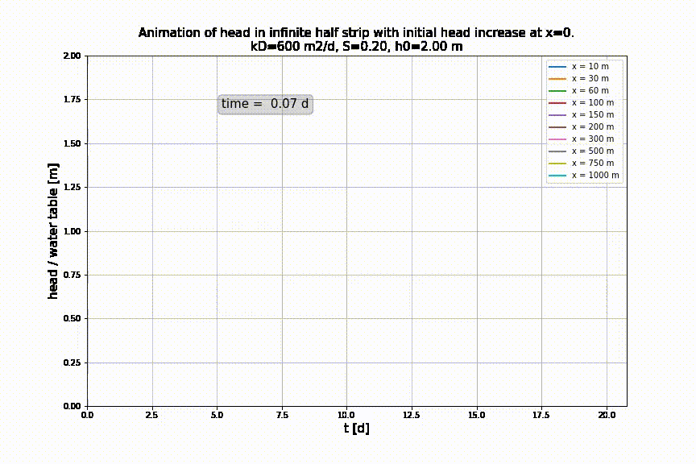
Aquifer intruded at x=0 by sudden change. As a funtion of time for various x

Slide 28
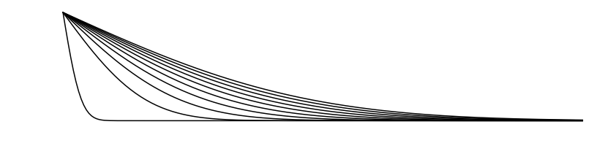
Head change due to sudden head change at x=0
h(x,0)
Drawdown progression
Water table h(x, t) declines with time (= drawdown)
h(x,∞)

Slide 29
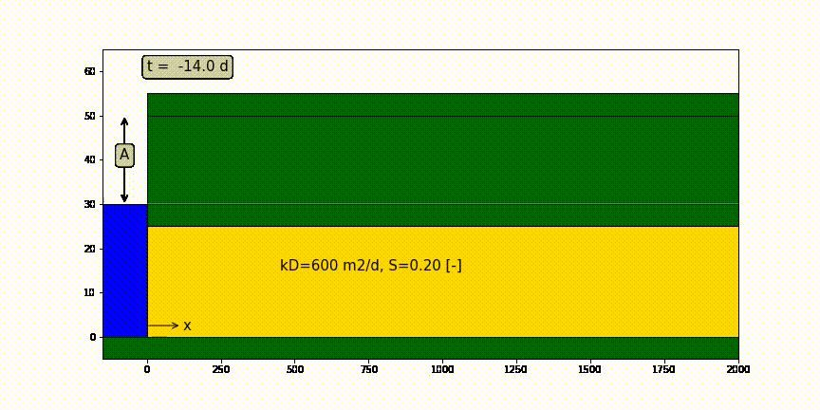
Confined aquifer of half-infinite extent with sudden head change A [m] at x=0 and t=0

Slide 30
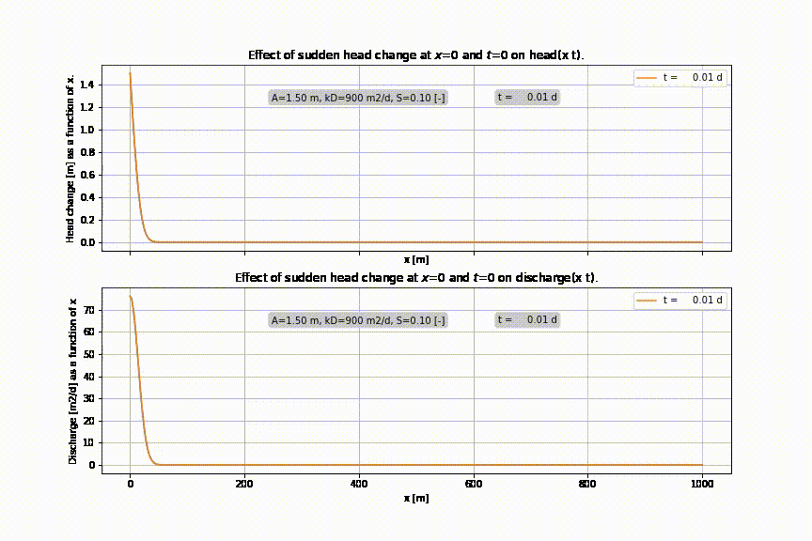

Slide 31
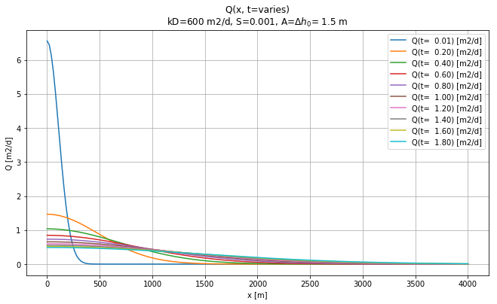
Discharge at different time due to sudden head change at x=0

Slide 32
Section 5.4.5 Superposition in time

Slide 33
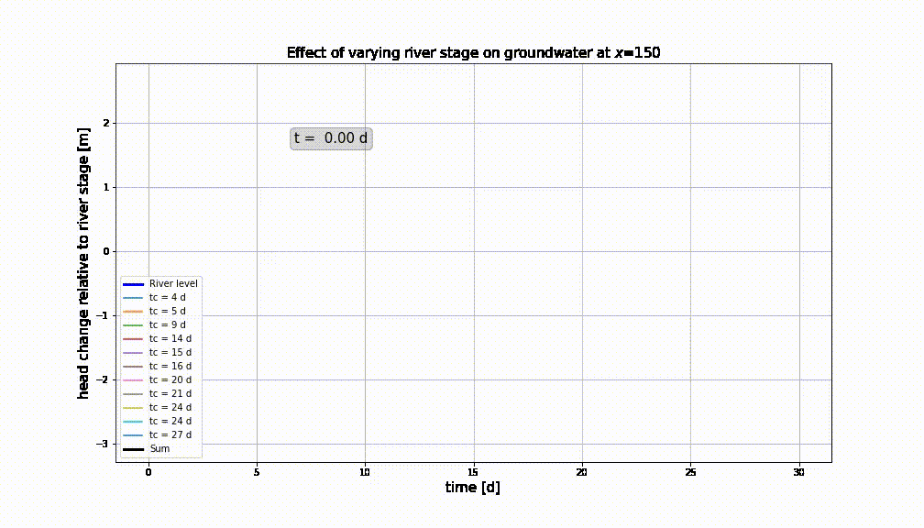
Varying river water level at x=0 → do superposition in time

Slide 34
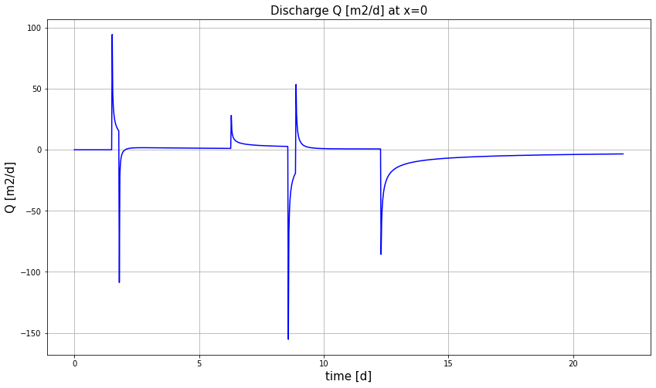
Discharge at the river will give a peak each time the head changes

Slide 35
Section 5.5. Aquifers of limited extent
Still 1D, but the aquifer has limited width.
The river leven my change suddenly on either or both sides.
This requires superposition in space

Slide 36
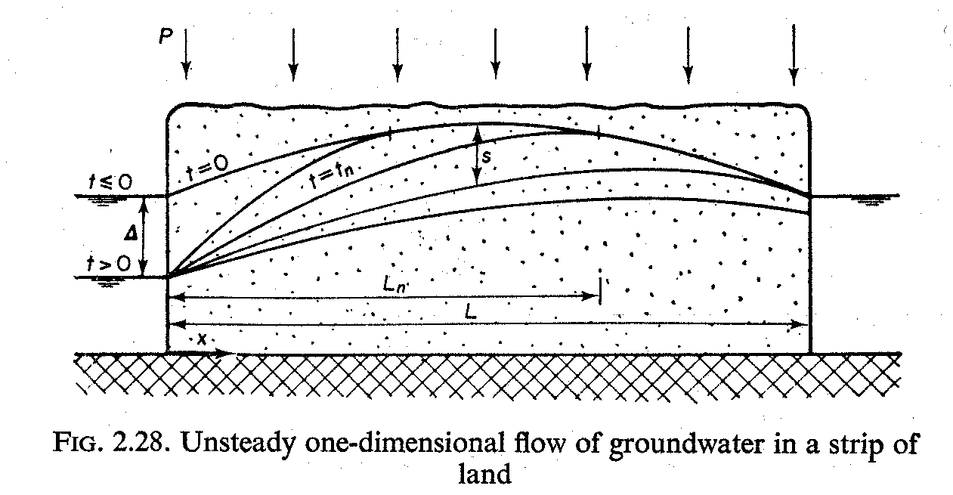
Aquifer is bounded between two fixed-head boundaries, what to do?

Slide 37
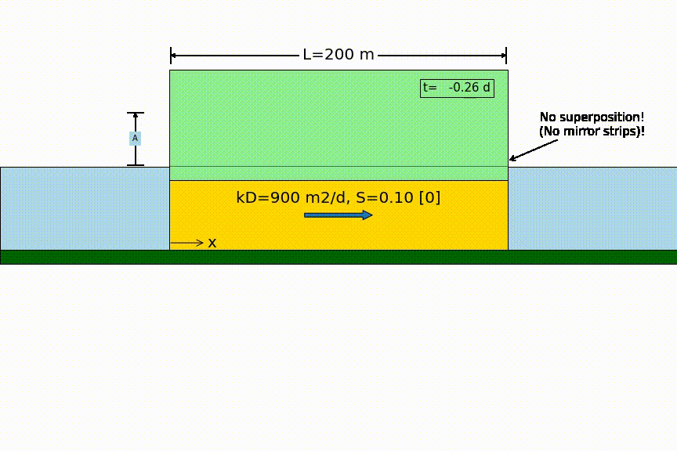
Head changes suddenly on one side

Slide 38
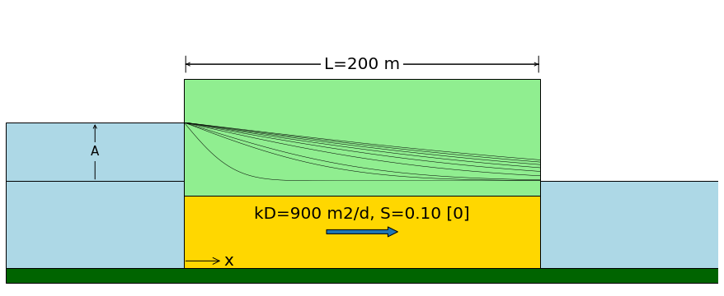
Head changes suddenly on one side
Sudden water level change by A
no longer zero !

Slide 39
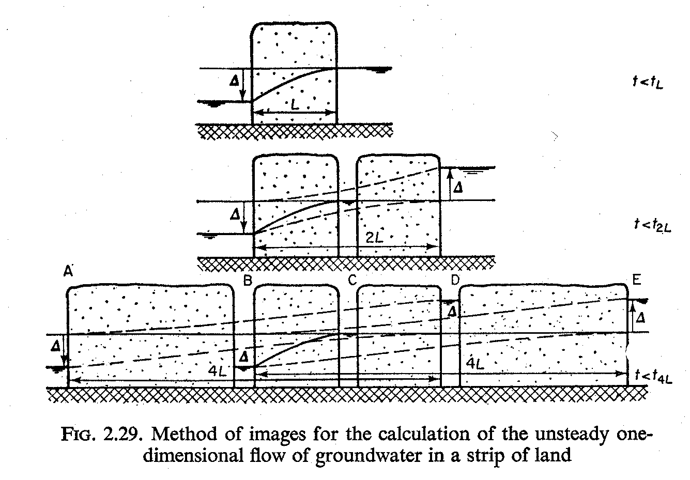
Aquifer is bounded between two fixed-head boundaries→ superposition in space

Slide 40
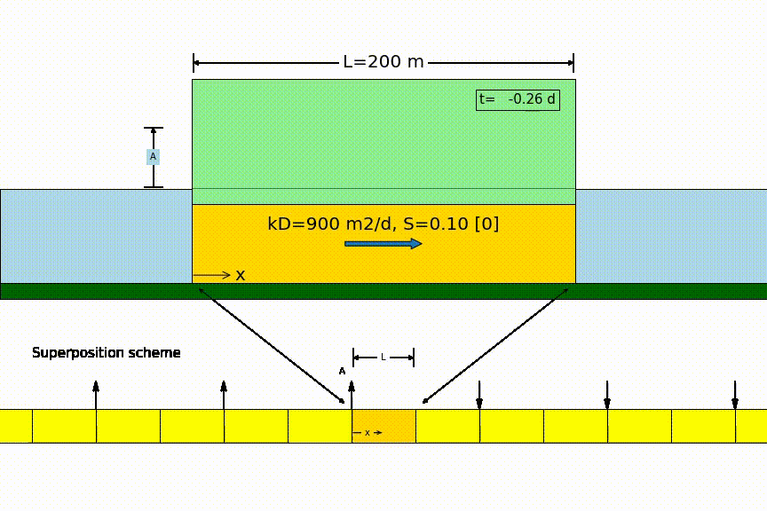
Head changes suddenly on one side

Slide 41
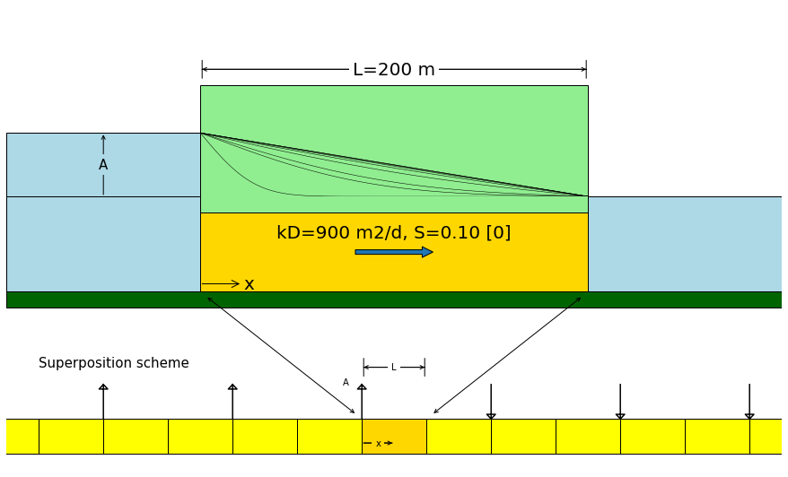
Head changes suddenly on one side
zero

Slide 42
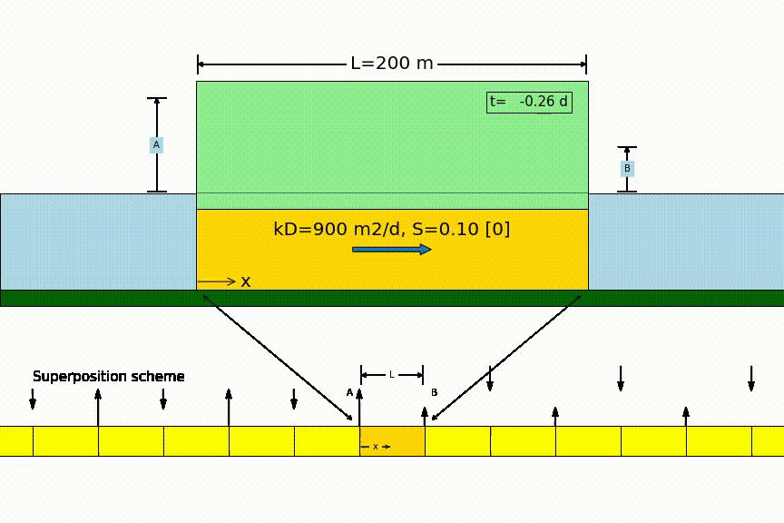
Head changes suddenly on two sides

Slide 43
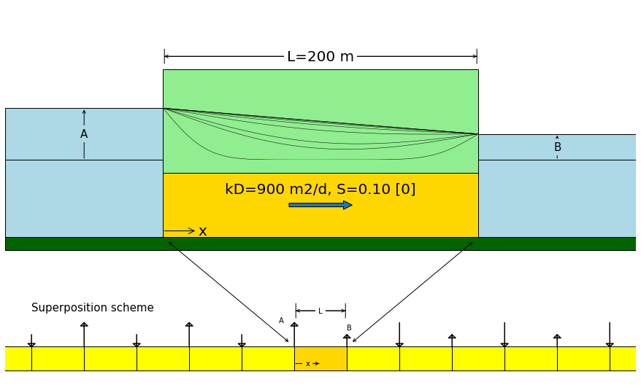
Head changes suddenly on both sides

Slide 44
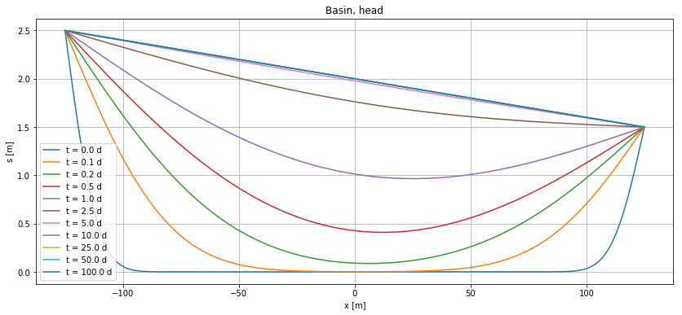
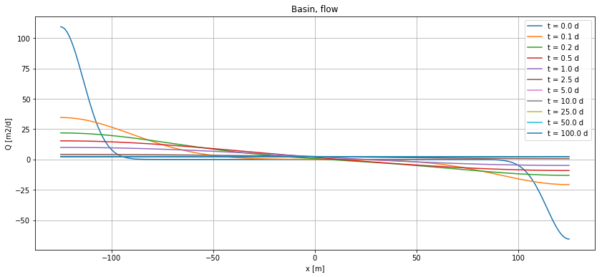
Head changes suddenly on both sides

Slide 45
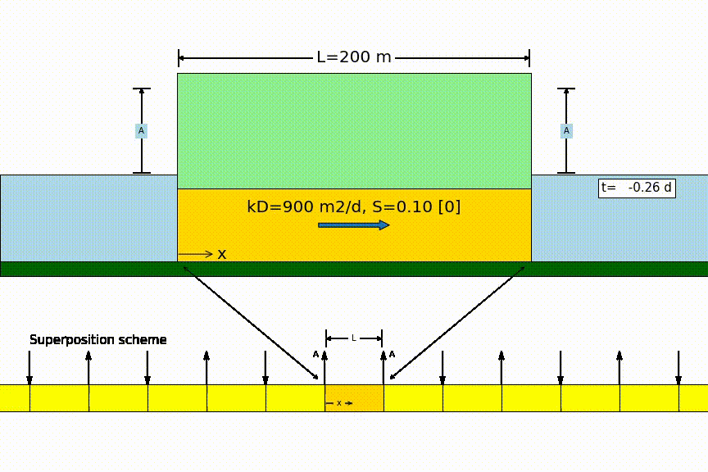
Symmetrical same sudden head change on both sides

Slide 46
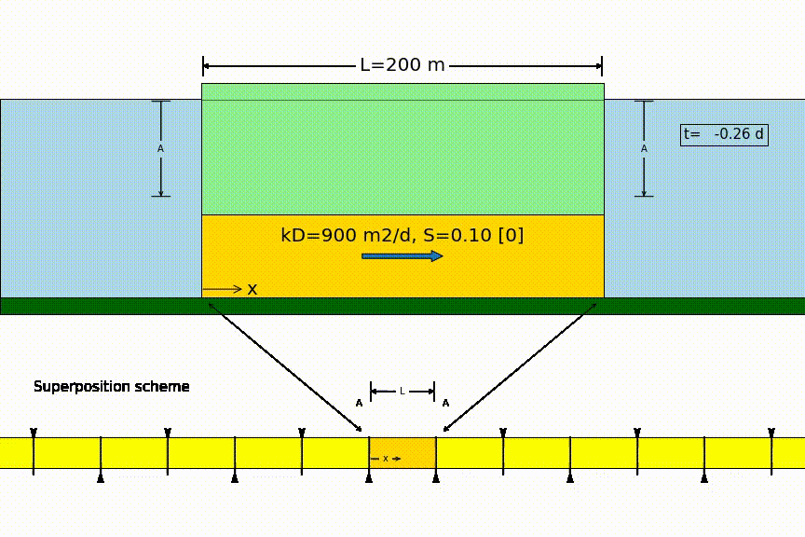
Strip drainage after sudden recharge

Slide 47
Questions and exercises
See section 5.5.5
See old exams bundle

Slide 48
Section 5.6: Groundwater basins
The strip of given width is a model of a groundwater basin.
Drainage characteristic, characteristic time, drainage half time
Comparison of basins with different properties.

Slide 49
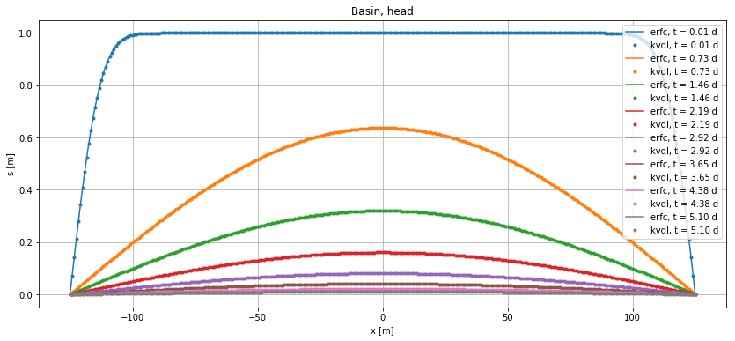
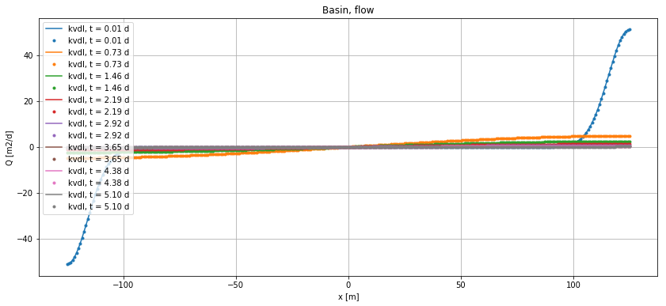
Basin drainage (two methods)

Slide 50
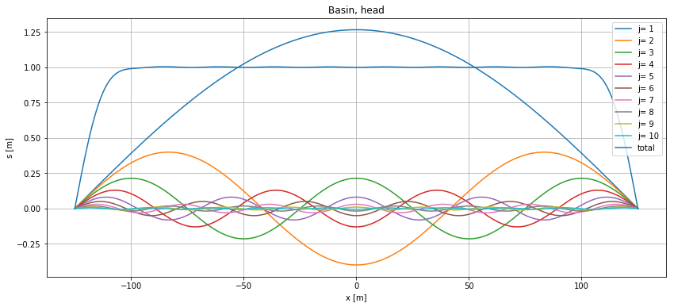
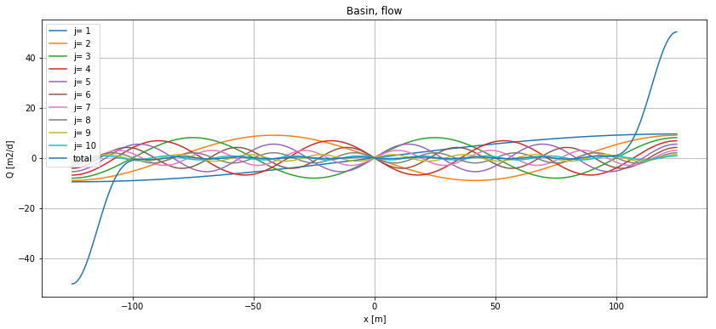
Individual terms of power series solution

Slide 51
How fast or slow is the groundwater system ??

Slide 52
Questions and exercises
See section 5.6.3
See old exams bundle.

